Slide 1
External Communications
Molly Brown, Peter Griffith,
Lucia Woo, Libby Larson,
Megan McGrody, David Lagomasino

Slide 2
Plans and Action Items
Descriptions of CMS Carbon Product categories and Thematic categories
We will draft, send to stakeholders, then send to PIs for review
Will use these to describe CMS products and projects
New ways to present information using:
Thematic products, project topics, scale, ARL levels
Linking to where the data is, once the stakeholder has found it
DAACs and PI-provided URLs, in coordination with Data WG
Feature ‘applications stories’ with Earth Observatory
CMS articles summaries for ‘Real Climate’ linked to carbon.nasa.gov

Slide 3
58 Stakeholders
Product Category
stocks | 84%
sources | 79%
sinks | 79%
flux / movement | 81%
ecosystem composition and structure | 79%
disturbance | 71%
evaluation and user interface | 31%
uncertainties | 48%
Thematic Category
Global Surface-Atmosphere Flux | 9%
Land-Atmosphere Flux | 43%
Ocean-Atmosphere Flux | 14%
Land-Ocean Flux | 10%
Ocean Biomass | 7%
Land Biomass | 48%
Atmospheric Transport | 16%
Measurement, Reporting and Verification | 66%
Frequency
(daily, weekly, monthly, annual)
Regulatory Scale
(subnational, national, international,
global)

Slide 4
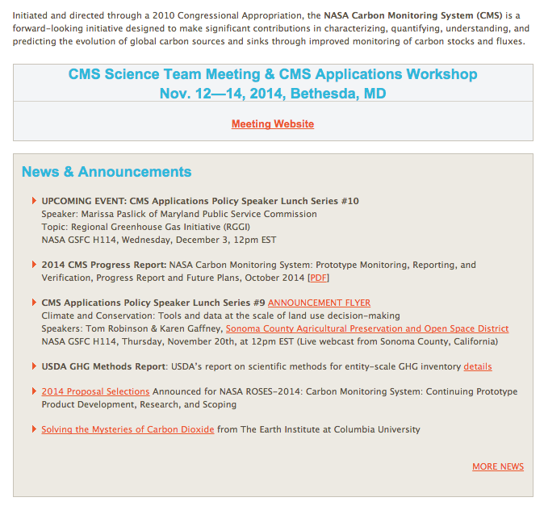
Website front page
CMS
Products
Add ways to
Navigate to the
information of
interest, while
maintaining the
front page area for
announcements and
news for PIs
CMS
Projects
CMS by
Regulatory Scale

Slide 5
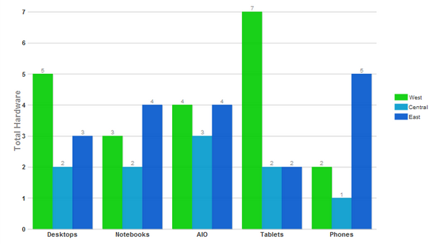
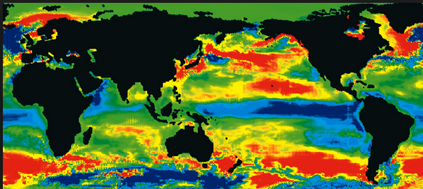
Product Fact Sheet
In collaboration with the Data WG, we will examine the questions on the Data Fact Sheet to reduce redundancies and unimportant information
Product format (netCDF, geoTiff, etc)
Engagement of stakeholders beyond existing set
what information is missing from product fact sheet
presentation of comparison of similar products, uncertainty information, guidance on use
excel | 60%
kml | 29%
hdf | 19%
netcdf | 17%
ascii | 9%
geotiff | 36%
mxd | 0%
shape | 33%
other | 0%
OR

